Slide 1
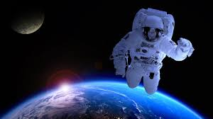
Day of the Universe
Światowy Dzień Kosmosu
https://www.fullofideas.pl/2015/01/across-universe/

Slide 9
Karty pracy- klik
COUNTING DOWN FROM 10 ROCKET
My rocket

